Slide 1
Introduction to HTML
Presented by:
H D Nandeesh
Assistant Professor, CSE
SJCE, Mysore -570009
Id: hdnandeesh@sjce.ac.in
hdnandeesh@gmail.com
M: +91 - 9538349705

Slide 2
Content:
Basic Introduction
Usage
HTML document format
Basic HTML tags
Paragraph Tags
Formatting Tags
Phrase Tags
Comments
Images
Tables
Lists
Backgrounds
Frames
Forms

Slide 3
Introduction
What basically HTML is..?
Hyper Text Markup Language
Hypertext refers to the links to the other web pages
Markup Language uses tags that tell a Web browser how to structure text document to display.

Slide 4
Uses
Web page development.
Web document creation.
Cutting edge feature
Responsive images on web pages
Client-side storage
Offline capabilities usage
Data Entry support with HTML
Game development usage
Native APIs usage to enrich website

Slide 5
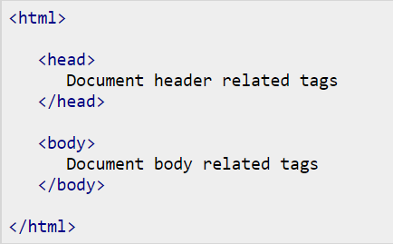
Basic HTML Structure

Slide 6
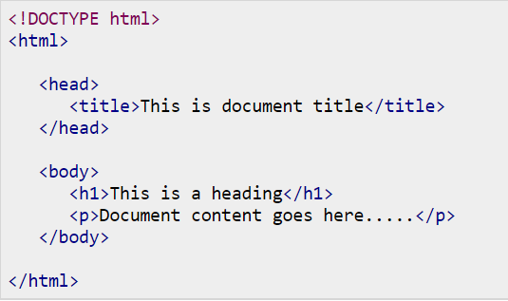
Basic HTML document

Slide 7
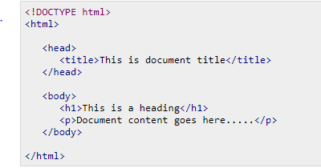
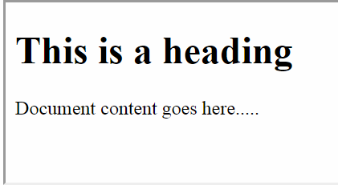
Result

Slide 8
Tag and Description
<!DOCTYPE...> - Defines the document type and HTML version.
<html> - This tag encloses the complete HTML document and mainly comprises of document Head and Body Tags
<head> - This tag represents the document's header which can keep other HTML tags like <title>, <link>.
<title> - The <title> tag is used inside the <head> tag to mention the document title.
<body> - This tag represents the document's body which keeps other HTML tags like <h1>, <div>, <p> etc.
<h1> - This tag represents the heading.
<p>This tag represents a paragraph.

Slide 9
HTML Tags
HTML makes use of various tags to format the content.
These tags are enclosed within angle braces <Tag Name>.
Most of the tags have their corresponding closing tags. Except few tags
Example <html> has its closing tag </html> and <body> tag has its closing tag </body> tag etc.
The tags does not require closing tags are considered as Void tags

Slide 10
Basic HTML tags
Heading Tags
Paragraph Tag
Line Break Tag
Centering Content Tag
Horizontal Lines
Preserve Formatting
Nonbreaking Spaces

Slide 11
Heading Tags
Every documents starts with heading.
HTML uses six levels of heading
Each level of heading can be defined as <h1>, <h2>, <h3>, <h4>, <h5> and <h6>
While displaying heading, browser adds one line before and one line after that heading
After the heading the tag must be closed by </h>

Slide 12
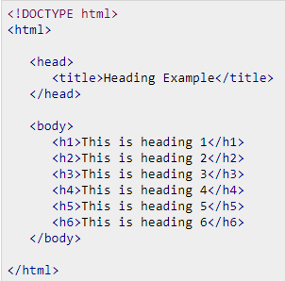
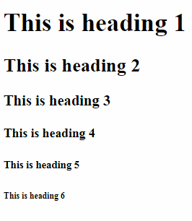
Example snippet

Slide 13
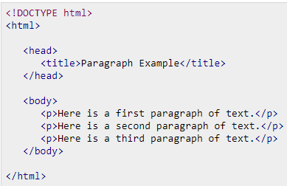
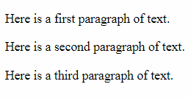
Paragraph Tag
The <p> tag offers a way to structure your text into different paragraphs.
Each paragraph of text should go in between an opening <p> and a closing </p> tag.

Slide 14
Line Break Tag
Whenever you use the <br /> element, anything following it starts from the next line.
This tag is an example of an empty element, where you do not need opening and closing tags, as there is nothing to go in between them.
The <br /> tag has a space between the characters br and the forward slash.
If you omit this space, older browsers will have trouble rendering the line break
while if you miss the forward slash character and just use <br> it is not valid in XHTML.

Slide 15
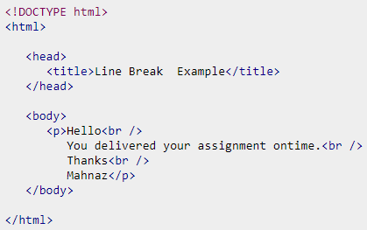
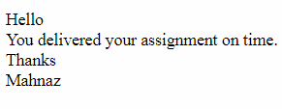

Slide 16
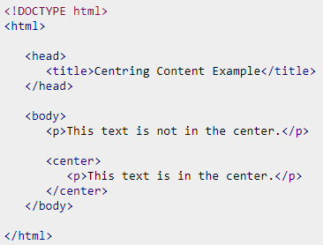

Centering Content
use <center> tag to put any content in the center of the page or any table cell.

Slide 17
Horizontal Lines
Horizontal lines are used to visually break-up sections of a document.
The <hr> tag creates a line from the current position in the document to the right margin and breaks the line accordingly.
The horizontal line also follows same structure of line break tag
Doesn't required open and closing of tag

Slide 18
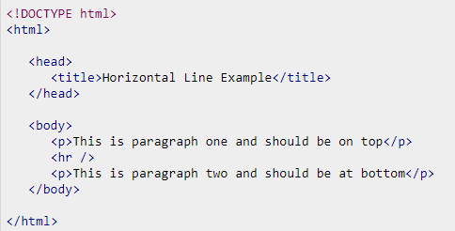
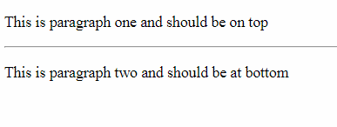

Slide 19
Preserve Formatting
Any text between the opening <pre> tag and the closing </pre> tag will preserve the formatting of the source document.
Sometimes, you want your text to follow the exact format of how it is written in the HTML document. In these cases, you can use the preformatted tag <pre>
The tag mainly used to preserve the actual content as it is.
Content is required in between the opening and closing tags

Slide 20
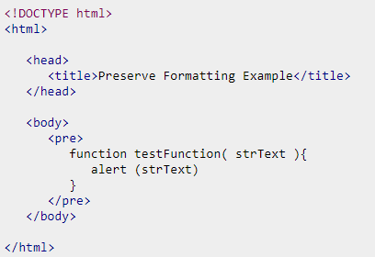
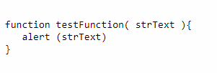

Slide 21
FORMATTING Tags
Bold Text
Italic Text
Underlined Text
Strike Text
Monospaced Font
Superscript Text
Subscript Text
Inserted Text
Deleted Text
Larger Text
Smaller Text
Grouping Content

Slide 22
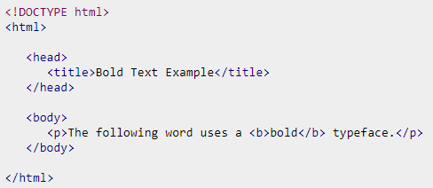

Bold Text

Slide 23
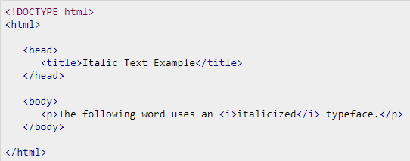

Italic Text

Slide 24
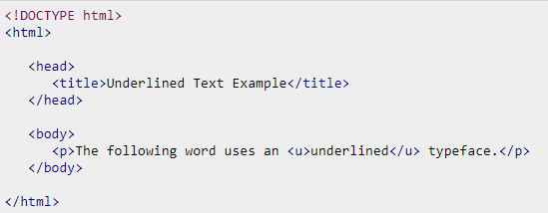

Underlined Text

Slide 25
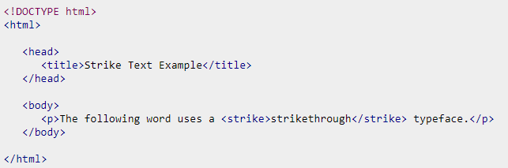

Strike Text

Slide 26
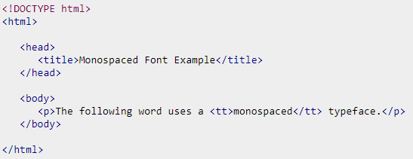

Monospaced Tag

Slide 27
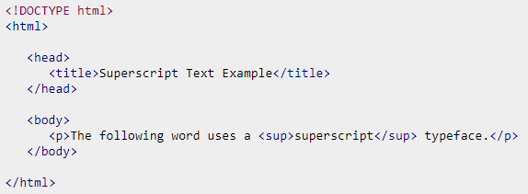

Superscript Text

Slide 28
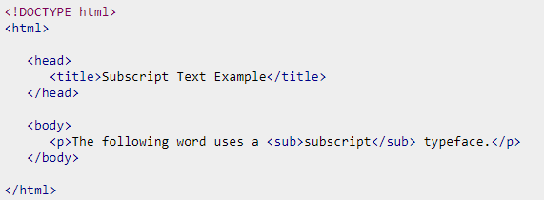

Subscript Text

Slide 29
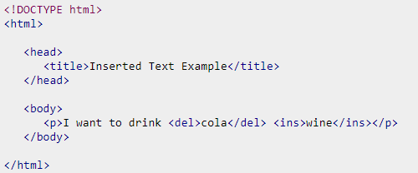

Deleted Text

Slide 30
Grouping Content
The <div> tag or elements allow you to group together several elements to create sections or subsections of a page.
Most of the grouping content uses attribute- value relationship.
Attach a style to this <div> element so that they appear using a special set of style rules.

Slide 31
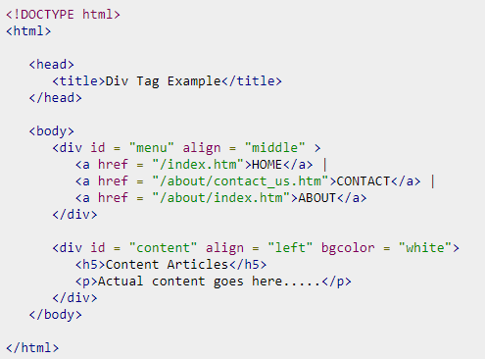
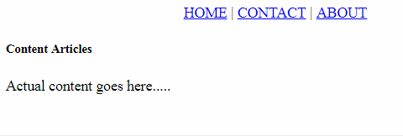

Slide 32
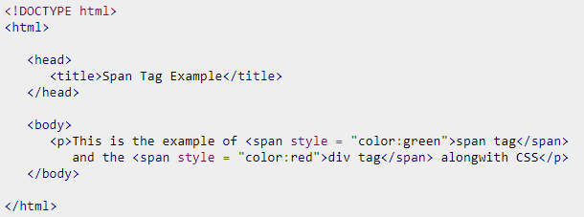

Another grouping element in HTML Is <span>
It can be used to group inline elements only.

Slide 33
HTML - PHRASE TAGS
Emphasized Text
Marked Text
Strong Text
Text Direction
Quoting Text
Programming Variables
Address Text

Slide 34


Emphasized Text

Slide 35
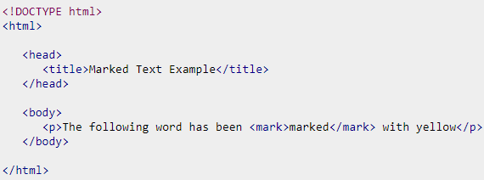

Marked Text

Slide 36
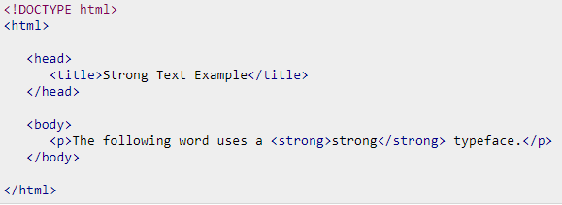

Strong Text

Slide 37
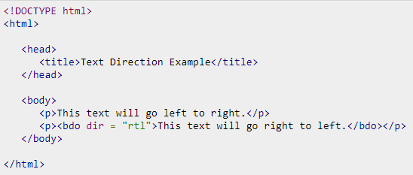

Text Direction
Note: bdo refers to bydirectional override

Slide 38
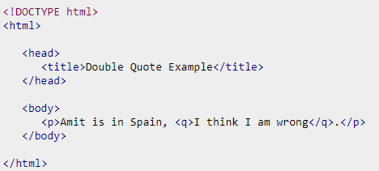

Short Quotations

Slide 39
HTML - COMMENTS
Comment is a piece of code which is ignored by any web browser.
Its good to add comments in complex documents, to indicate sections of a document, and any other notes to anyone looking at the code.
Comments help you and others understand your code and increases code readability.
HTML comments are placed in between <!-- ... --> tags.
Any content placed with-in <!-- ... --> tags will be treated as comment and will be completely ignored by the browser.

Slide 40
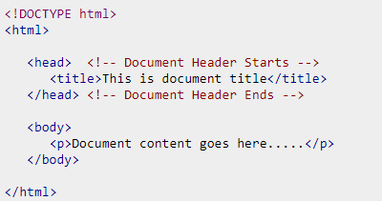

Valid Comments

Slide 41
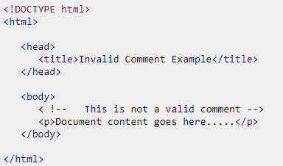

Invalid Comment

Slide 42
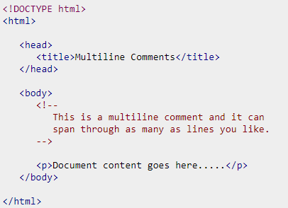

Multiline Comments

Slide 43
HTML - IMAGES
Images enriches the content.
Images are used beautify as well as to depict many complex concepts in simple way on the web page.
Inserting Image
Setup the Image Location
Set Image Width/Height
Set Image Border
Set Image Alignment

Slide 44
Inserting an Image
You can insert any image in your web page by using <img> tag.
Following is the simple syntax to use Image tag.
The <img> tag is an empty tag.
It can contain only list of attributes and it has no closing tag.
It is also considered as Void tag.
Img tag accept .PNG, .JPEG or .GIF image extension file.
The alt attribute is a mandatory which specifies an alternate text for an image, if the image cannot be displayed.

Slide 45
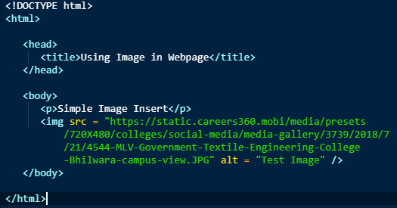
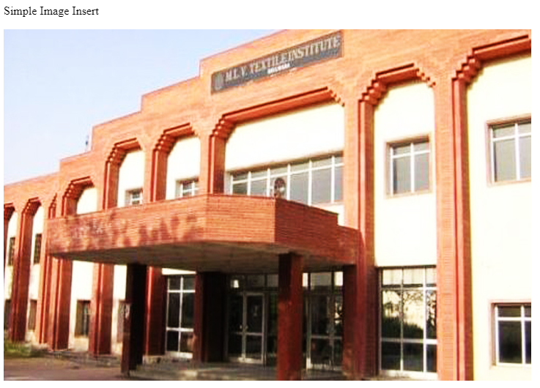

Slide 46
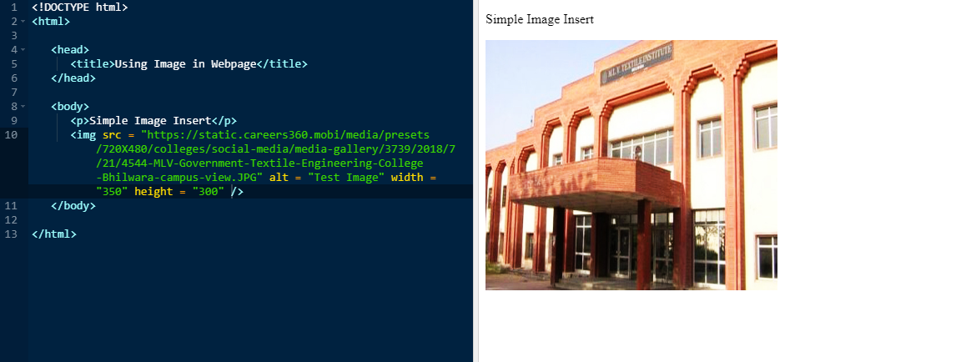
Set Image Width/Height
By using attributes width and height you can set the image height and width based on your requirement.
You can specify width and height of the image in terms of either pixels or percentage

Slide 47
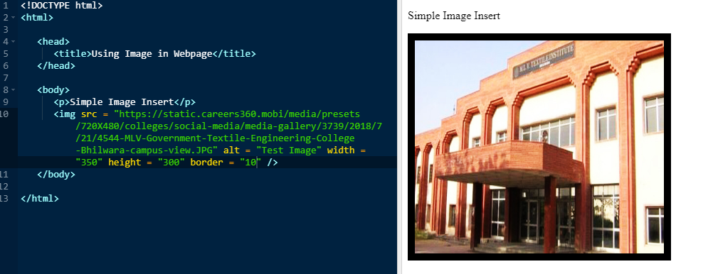
Set Image Border
Developer can specify border thickness in terms of pixels using border attribute.
A thickness of 0 means, no border around the picture.

Slide 48
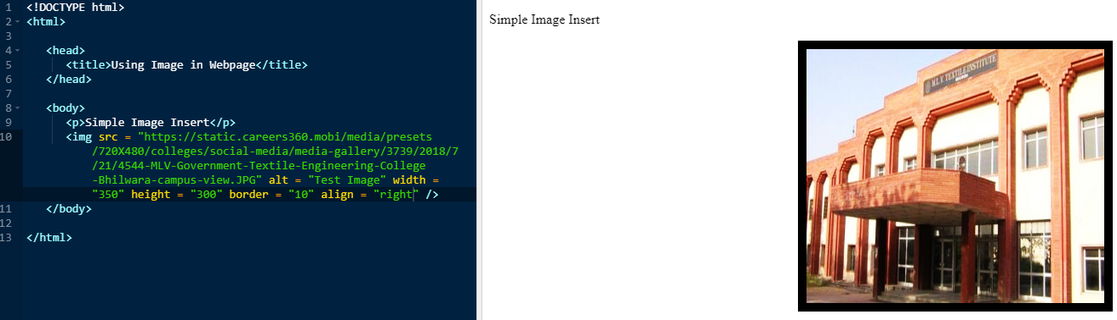
Set Image Alignment
By default the images are aligned at web page left side.
you can use align attribute to set it in the center or right.

Slide 49
HTML - TABLES
The HTML tables allow web authors to arrange data like text, images, links, other tables, etc. into rows and columns of cells.
The HTML tables are created using the <table> tag
<tr> tag is used to create table rows and <td> tag is used to create data cells.
The elements under <td> are regular and left aligned by default

Slide 50
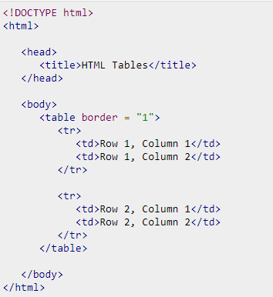

Example

Slide 51
Table Heading
Table heading can be defined using <th> tag.
This tag will be put to replace <td> tag, which is used to represent actual data cell.
you can use <th> element in preferably on top row.
Headings, which are defined in <th> tag are centered and bold by default.

Slide 52
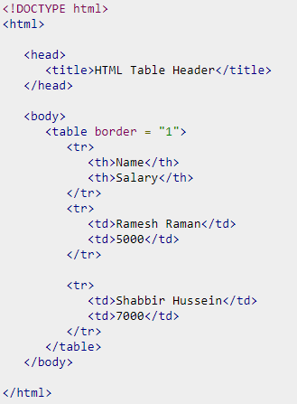
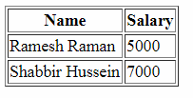

Slide 53
Cellpadding and Cellspacing Attributes
These two tags are used to adjust the white space in your table cells.
The cellspacing attribute defines space between table cells.
cellpadding represents the distance between cell borders and the content within a cell.

Slide 54
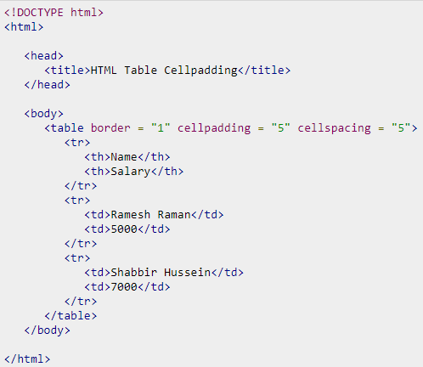
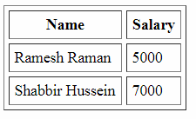

Slide 55
Colspan and Rowspan Attributes
colspan attribute can be used to merge two or more columns into a single column.
Similar way rowspan attribute contribute in merging two or more rows into single row.

Slide 56
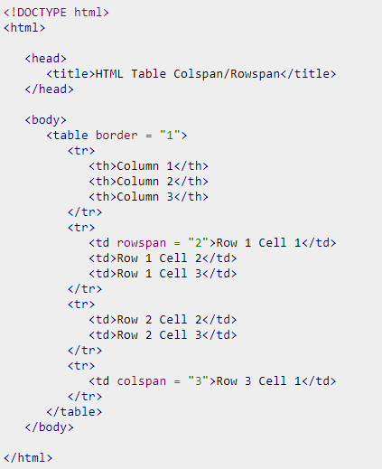
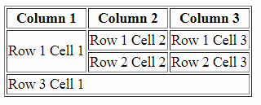

Slide 57
Tables Backgrounds
You can set table background using one of the following two ways
- bgcolor attribute − You can set background color for whole table or just for one cell.
- background attribute − You can set background image for whole table or just for one cell.
You can also set border color also using bordercolor attribute.

Slide 58
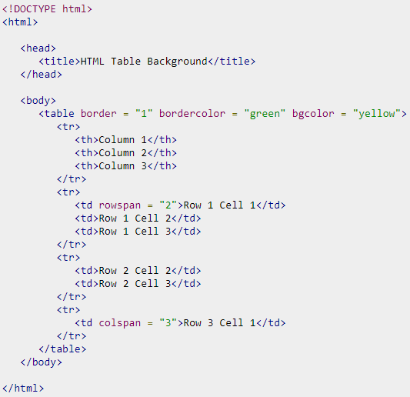
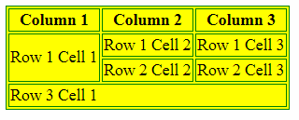

Slide 59
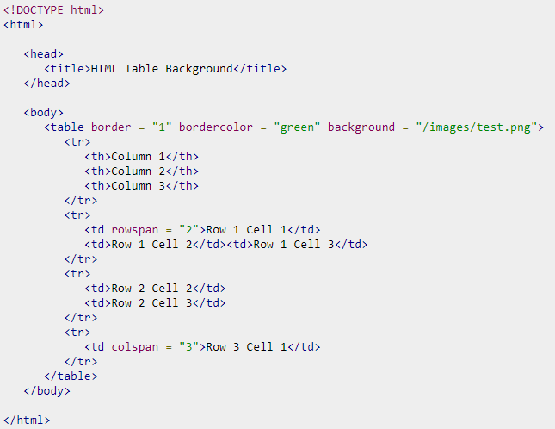
Background Image

Slide 60
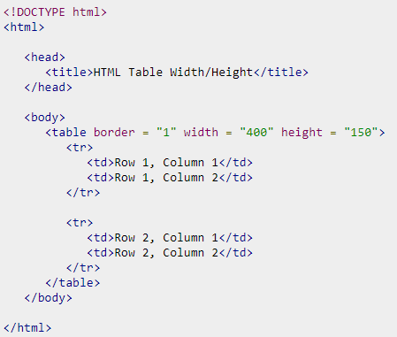
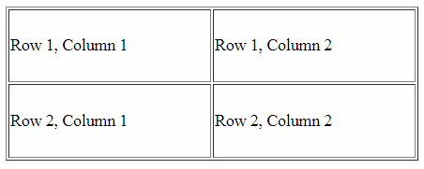
Table Height and Width

Slide 61


Nested Tables

Slide 62
HTML - LISTS
HTML offers web authors three ways for specifying lists of information.
<ul> − An unordered list. This will list items using plain bullets.
<ol> − An ordered list. This will use different schemes of numbers to list your items.
<dl> − A definition list. This arranges your items in the same way as they are arranged in a dictionary.

Slide 63

HTML Unordered Lists
An unordered list is a collection of related items that have no special order or sequence.
The list is created by using HTML <ul> tag.
Each item in the list is marked with a bullet.
The type Attribute – By default, The type of bullet is disc.
You can use type attribute for <ul> tag to specify the type of bullet you like.

Slide 64


Example

Slide 65



Square Example

Slide 66

HTML Ordered Lists
If you are required to put your items in a numbered list instead of bulleted, then HTML ordered list will be used.
This list is created by using <ol> tag.
The numbering starts at one and is incremented by one for each successive ordered list element tagged with <li>.
The type Attribute

Slide 67



Slide 68






Slide 69
HTML - FRAMES
HTML frames are used to divide your browser window into multiple sections.
Each section can load a separate HTML document.
A collection of frames in the browser window is known as a frameset.
The window is divided into frames in a similar way the tables are organized: into rows and columns.

Slide 70
Disadvantages of Frames
Some smaller devices cannot cope with frames often because the screen is not big enough to be divided up.
Sometimes your page will be displayed differently on different computers due to different screen resolution.
The browser's back button might not work as the user hopes.
There are still few browsers that do not support frame technology.

Slide 71
Creating Frames
To use frames on a page we use <frameset> tag instead of <body> tag.
The <frameset> tag defines, how to divide the window into frames.
The rows attribute of <frameset> tag defines horizontal frames
cols attribute defines vertical frames.
Each frame is indicated by <frame> tag and it defines which HTML document shall open into the frame.

Slide 72


Slide 73

Result of frame

Slide 74

Frames divided into columns

Slide 75

Result

Slide 76

HTML - BACKGROUNDS
Html Background with Colors
The bgcolor attribute is used to control the background of an HTML element
color_value can be given in any of the following formats.

Slide 77


Slide 78

Result

Slide 79
Html Background with Images
You can specify an image to set background of your HTML page or table.
The most frequently used image formats are JPEG, GIF and PNG images.

Slide 80


Slide 81


Slide 82
HTML - FORMS
HTML Forms are required, when you want to collect some data from the users.
For example, during user registration you would like to collect information such as name, email address, credit card, etc.
A form will take input from the user and then will post it to a back-end application.
The back-end application will perform required processing on the passed data.
There are various form elements available like text fields, textarea fields, drop-down menus, radio buttons, checkboxes, etc.

Slide 83
HTML Form Controls
Text Input Controls
Checkboxes Controls
Radio Box Controls
Select Box Controls
File Select boxes
Hidden Controls
Clickable Buttons
Submit and Reset Button

Slide 84



Slide 85


Password Text Control

Slide 86


Multiple-line text control

Slide 87


Checkbox Control

Slide 88


Radio Button Control

Slide 89


Select Box Control

Slide 90


Button Controls

Slide 91
Any questions….?

Slide 92
Thank You…!

